Slide 1
COMPUTER ORGANIZATION
Module-3

Slide 2
PIPELINING
BASIC PRINCIPLES
CLASSIFICATION OF PIPELINE PROCESSORS
INSTRUCTION AND ARITHMETIC PIPELINES (DESIGN EXAMPLES NOT REQUIRED)
HAZARD DETECTION AND RESOLUTION

Slide 3
Von Neumann Architecture
Evolution of computer architecture started with Von Neumann Architecture
Build as a sequential machine
Executing scalar data ( One instruction at time)
Disadvantage:
The von Neumann architecture system is slow due to sequential execution of instructions in programs
Major advancement came due to following techniques
Parallelism & pipelining

Slide 4
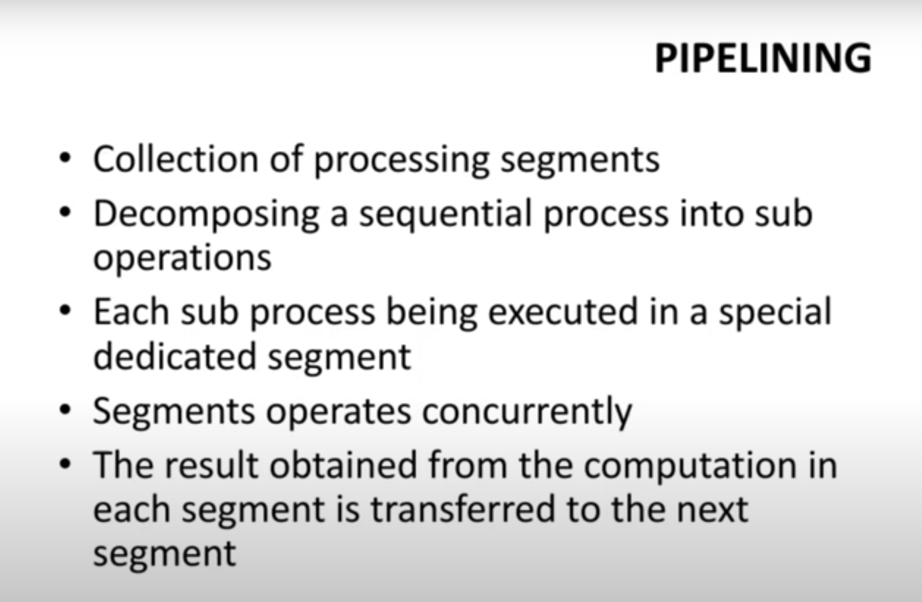

Slide 5
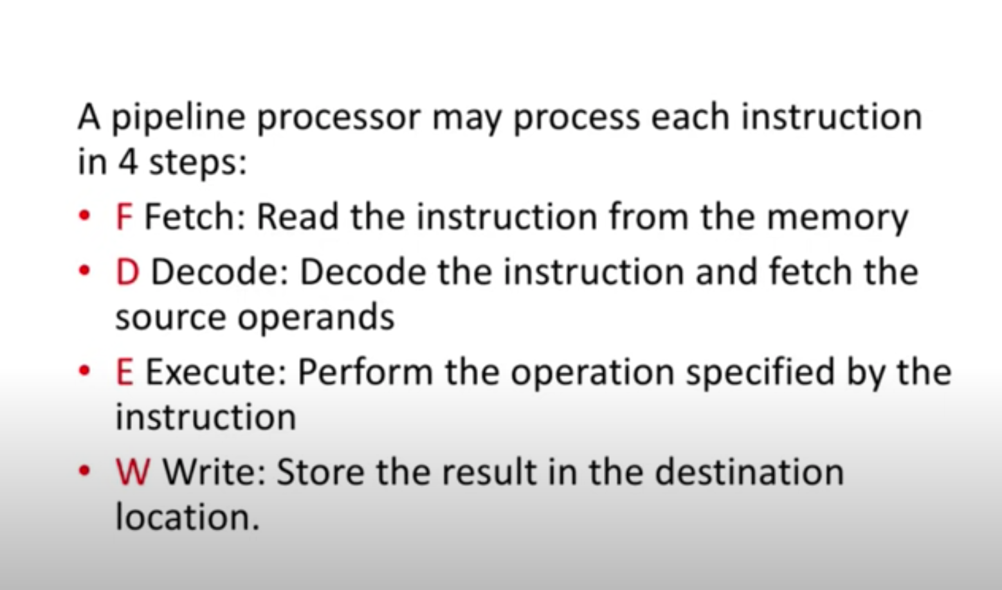
PIPELINING

Slide 6
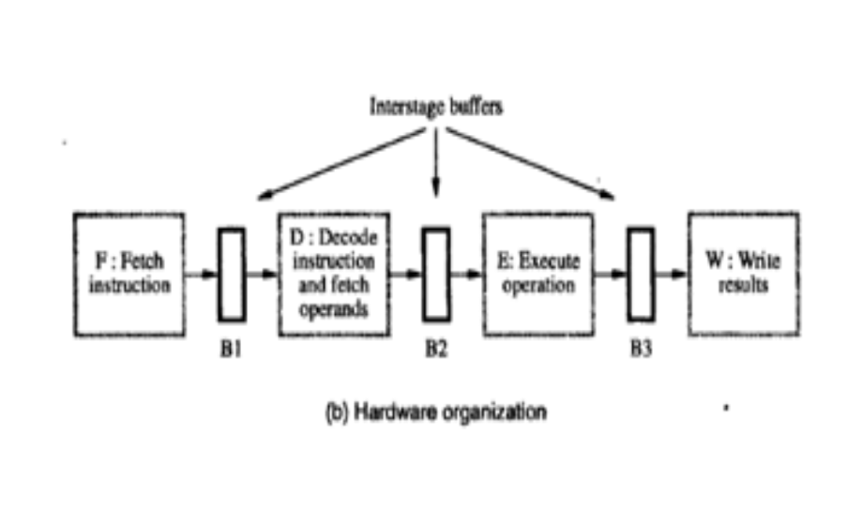
Pipelining hardware organization

Slide 7
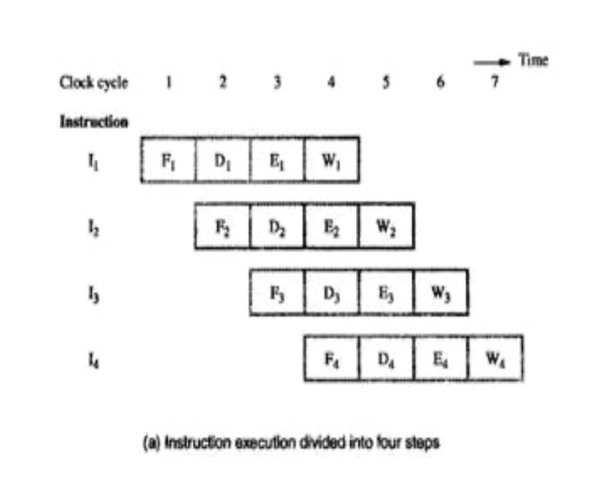
Instruction execution in piPelining

Slide 8
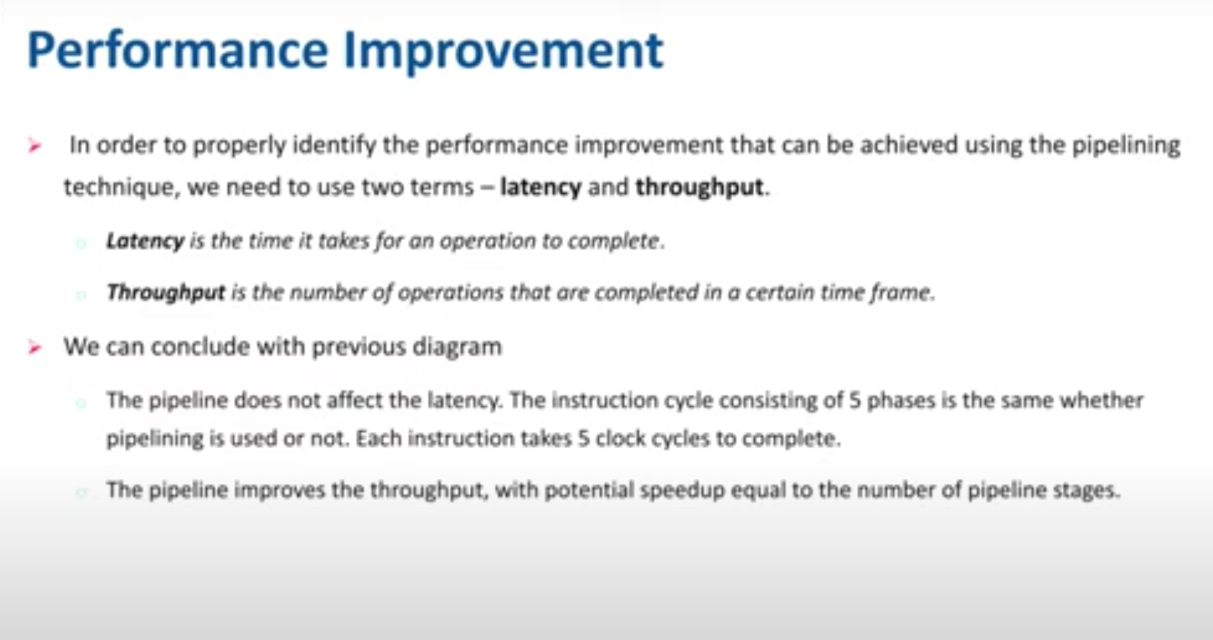

Slide 9
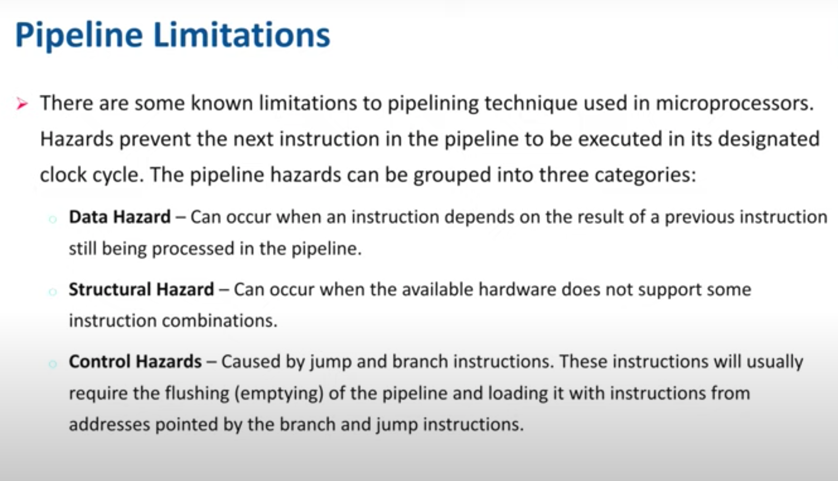

Slide 10
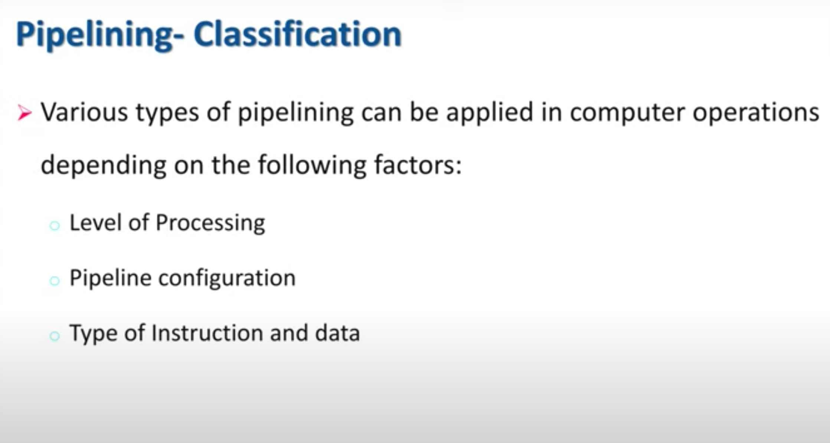

Slide 11
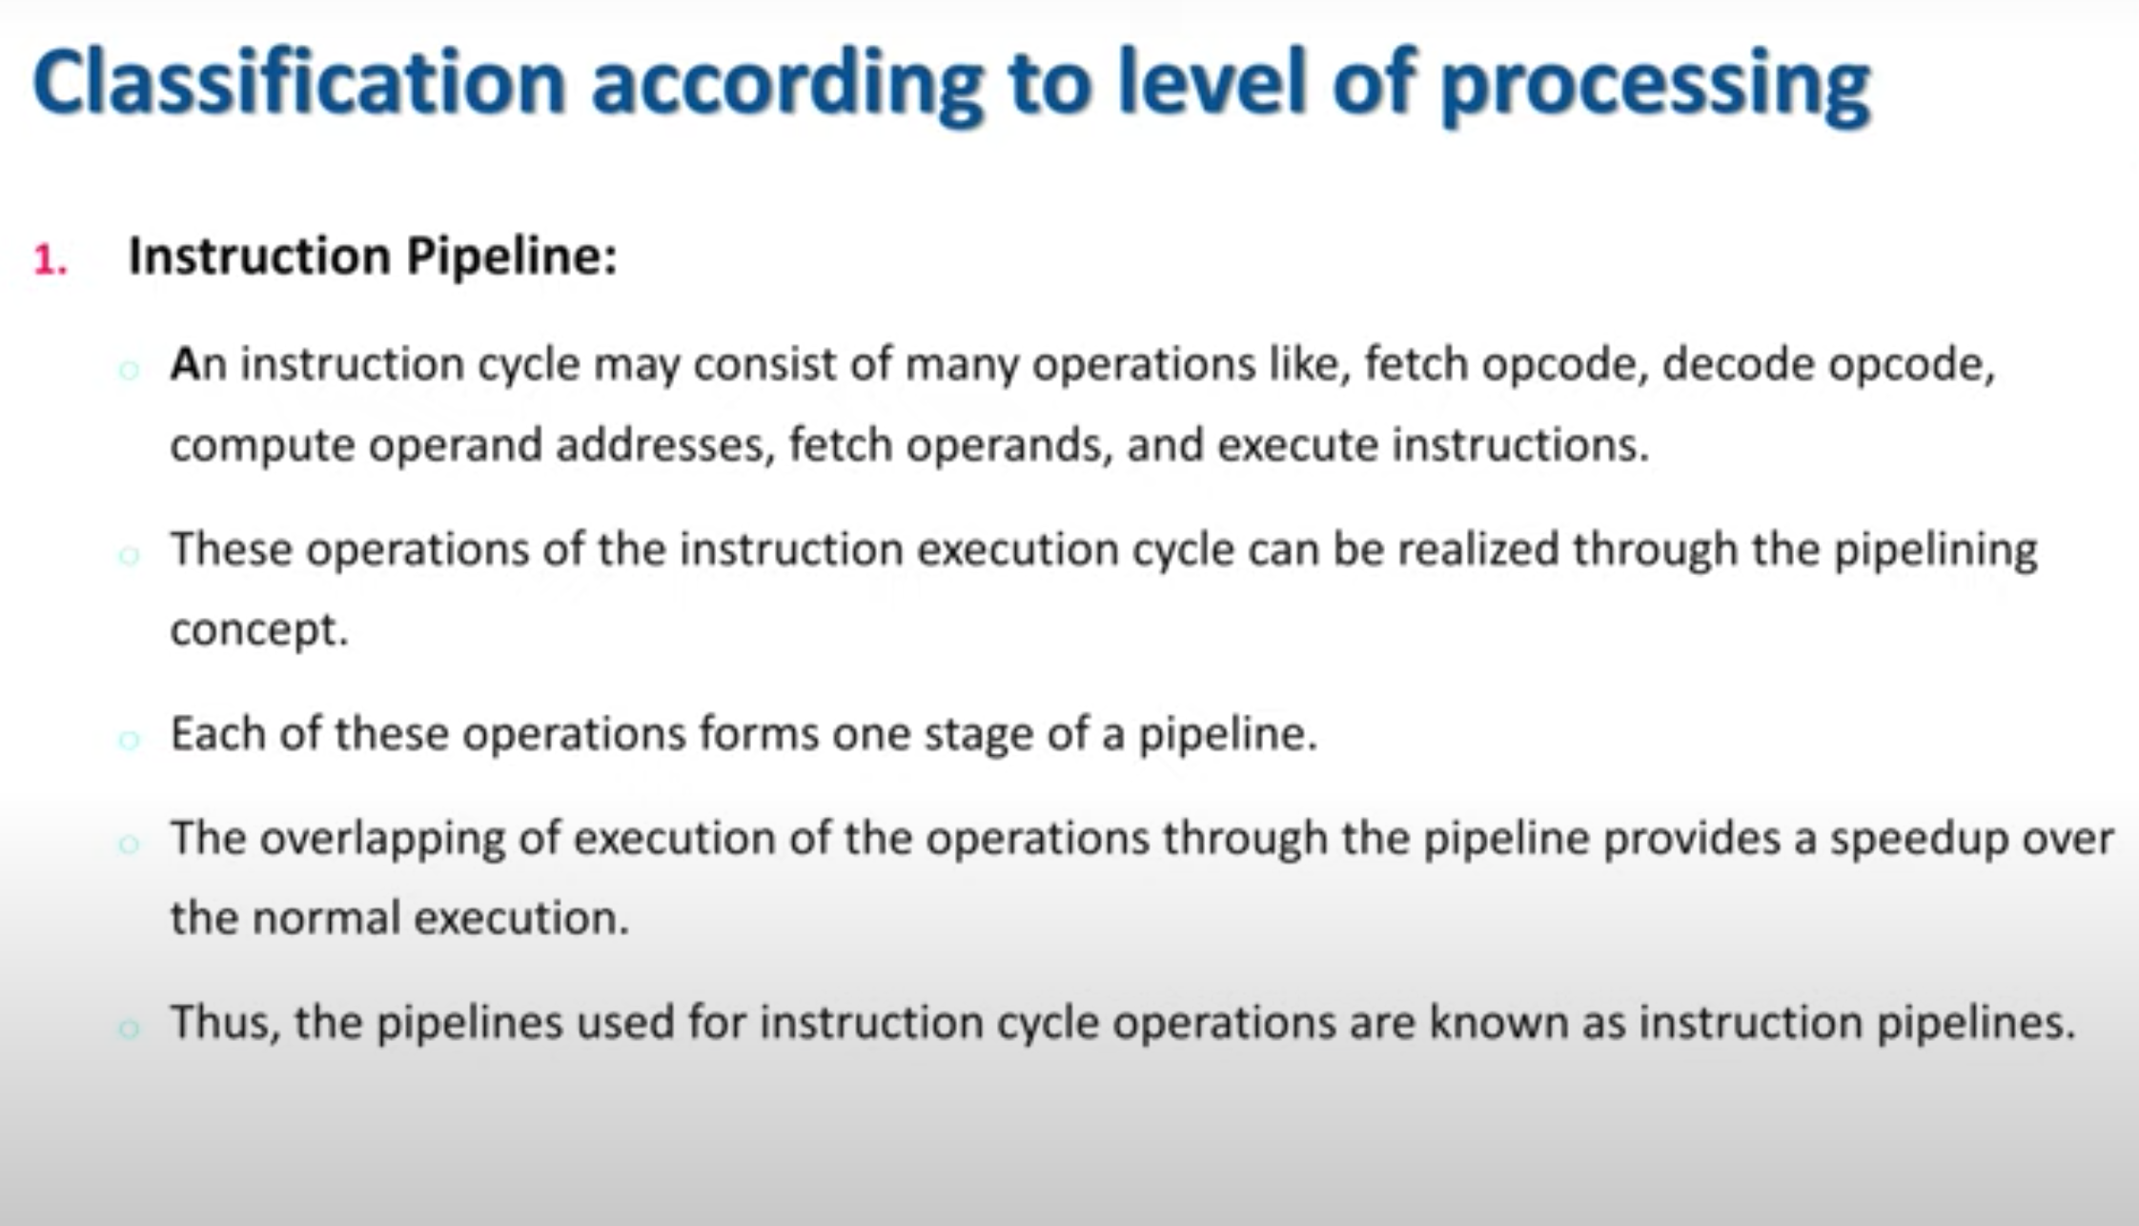

Slide 12
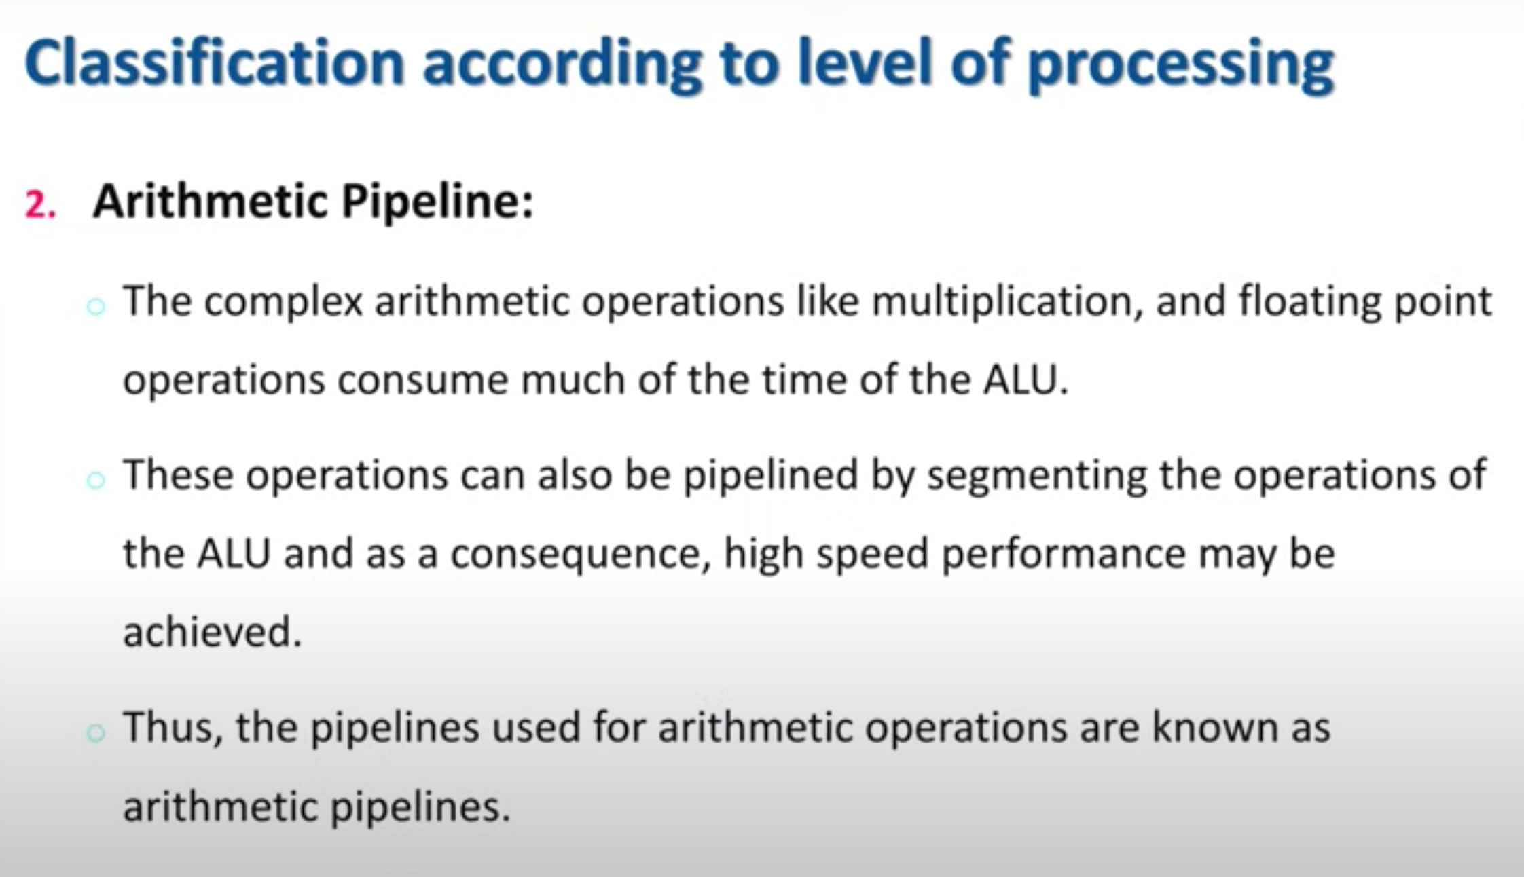

Slide 13
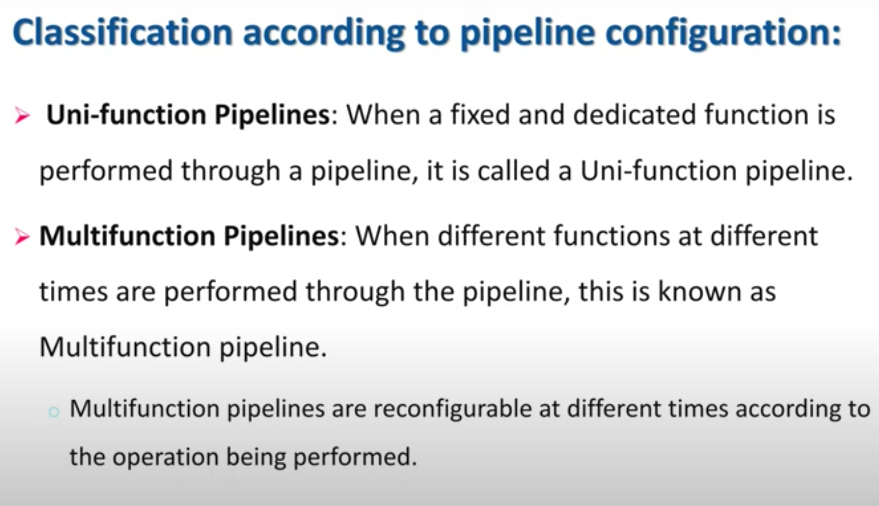

Slide 14
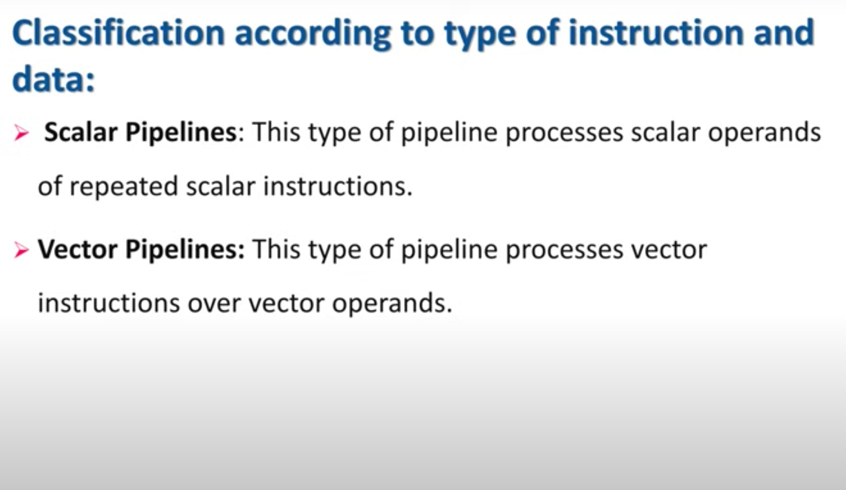

Slide 15
PIPELINE HAZARDZ
To execute several program segments in parallel, each segment has to be independent of the other segment
Dependency is the main challenge of pipeline

Slide 16
Types of HAZARDS
Data dependence
Control dependence
Resource dependence

Slide 17
DATA DEPENDENCE
Ordering relationship b/w statements are indicated by data dependence
Types
RAW ( Read After Write) hazard also Known as Flow dependence
WAR ( Write After Read) hazard also Known as Anti-dependence
WAW ( Write After Write ) hazard also Known as Output dependence

Slide 18
1. RAW ( Read After Write)
A statement S2 is flow dependent on statement S1,
if an execution path exists from S1 to S2, and if at least one output of S1 is fed as an input to S2
Eg: consider following instruction
S1: LOAD R1,A
S2: ADD R2,R1
S2 is flow dependent on S1
Coz o/p of S1 is fed as i/p of S2
Ie variable A is passed into register R1
also called Flow dependence

Slide 19
2. WAR ( Write After Read)
Statement S2 is anti-dependent on statement S1 if,
S2 follows S1 in program order and if o/p of S2 overlaps the input to S1
Denoted using a direct arrow crossed with a bar
Eg: consider the following statements
S2: ADD R2,R1
S3: move R1,R3
S3 is anti-dependent on S2 since S3 is overlapping the input to S2
Ie conflicts in the register content of R1
also called Anti-dependence

Slide 20
3. WAW ( Write After Write )
Two statements are output dependent if they produce the same output variable
Eg:
S1: LOAD R1,A
S3: MOVE R1,R3
S3 is output dependent on S1 coz they both modify the same register R1
Also called Output dependence

Slide 21
CONTROL DEPENDENCE
Implies that order of execution of statements cannot be determined before runtime
Conditional statements will not be resolved until runtime
Control dependency prohibits parallelism
Solution
Compiler techniques
Hardware Branch prediction technique

Slide 22
Control Dependence
Eg:
S1: if ( a==b )
S2 : a = a+b
S3 : b = a+b

Slide 23
RESOURCE DEPENDENCE
It is concerned with the conflicts in using shared resources in parallel areas
Shared resources are
Integer units
Floating point units
Registers
Memory areas
When conflicting resource is ALU➔ALU dependence
If conflict involve workplace storage➔ storage dependence

Slide 24
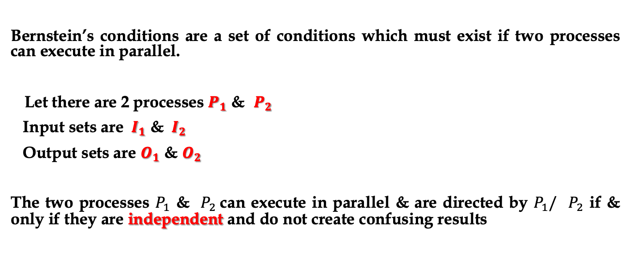
Bernstein’s conditions TO RESOLVE PIPELINE HAZARD
Bernstein’s conditions are a set of conditions which must exist if two processes can execute in parallel.
Let there are 2 processes $P_{1}$ & $P_{2}$
Input sets are ${ I}_{1}$ & ${ I}_{2}$
Output sets are $O_{1}$ & $O_{2}$
The two processes $P_{1}$ & $P_{2}$can execute in parallel & are directed by $P_{1}/$ $P_{2}$ if & only if they are independent and do not create confusing results

Slide 25
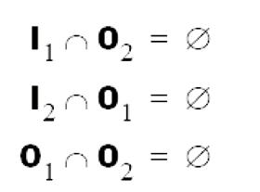
If P1 and P2 can execute in parallel (which is written as P1 || P2), then:
Flow Independent
Anti independent
Output independent

Slide 26
OTHER METHODS TO RESOLVE PIPELINE HARAZRD
Internal forwarding
Register- tagging
This concept was generalized into a technique known as data forwarding, which forward multiple copies of the data to as many waiting instructions as may wish to read it.
The internal forwarding and register- tagging techniques are helpful in resolving logic hazards in pipelines.

